Slide 1

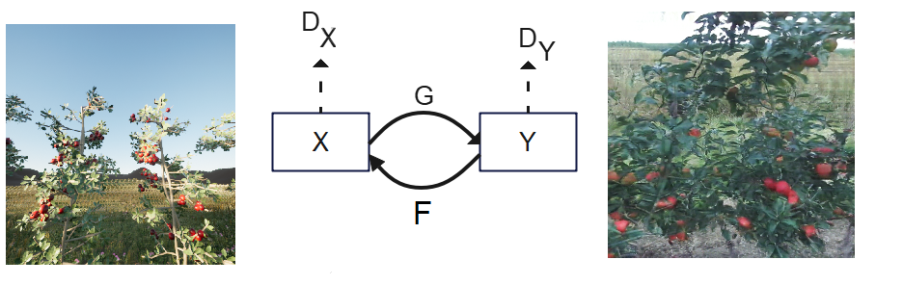
Style Transfer Using Generative Adversarial Networks (GANs)
Zulfiqar Ibrahim
Robotics Research Lab
Department of Computer Science
Technische Universität Kaiserslautern, Germany

Slide 2
Table of Contents
Motivation | 2
Project | 4
GANs | 7
Pro GANs | 9
Cyclic GANS | 13
Experiments & Results | 22
Problems & Future Work | 32
Questions | 33

Slide 3
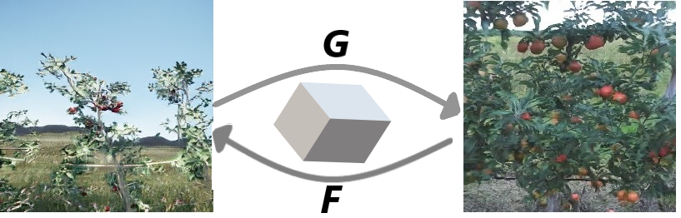
Motivation

Slide 4
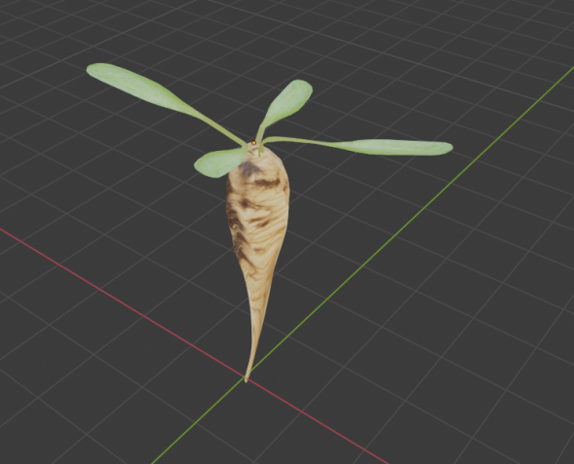
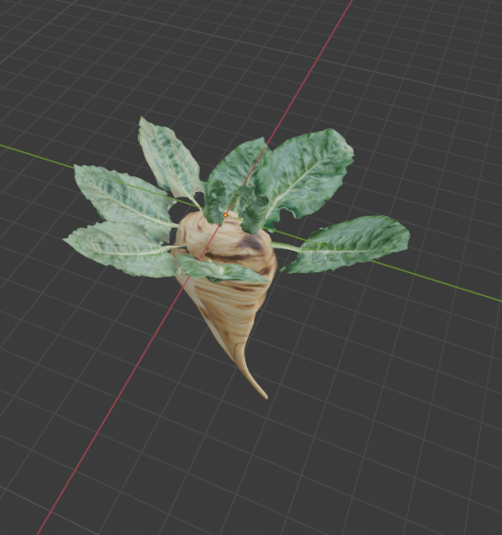
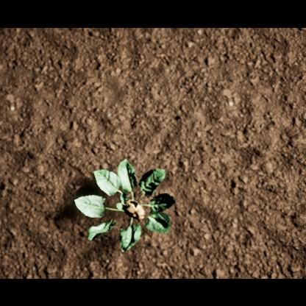
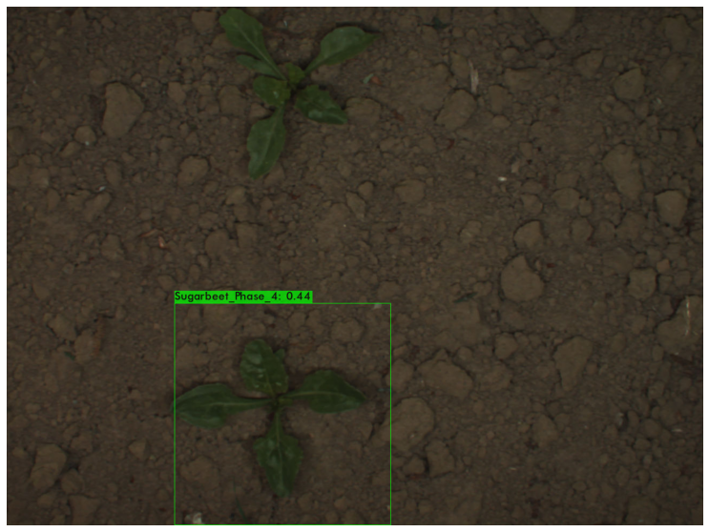
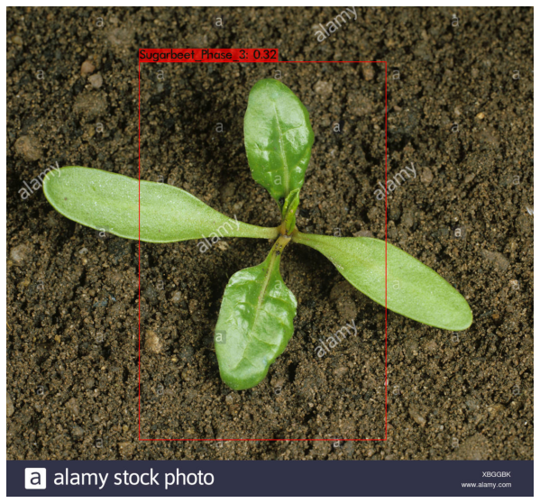
Project: Use of Synthetic Images of Sugar Beets For Age Classification of Real Images, through Deep Learning Network.
Design 3D models of sugar beets.
Use Unreal Engine for creation of
synthetic images.
Train deep learning classifier using synthetic Images.
Validate the classification score of the age of
real Images of sugar beet.

Slide 5
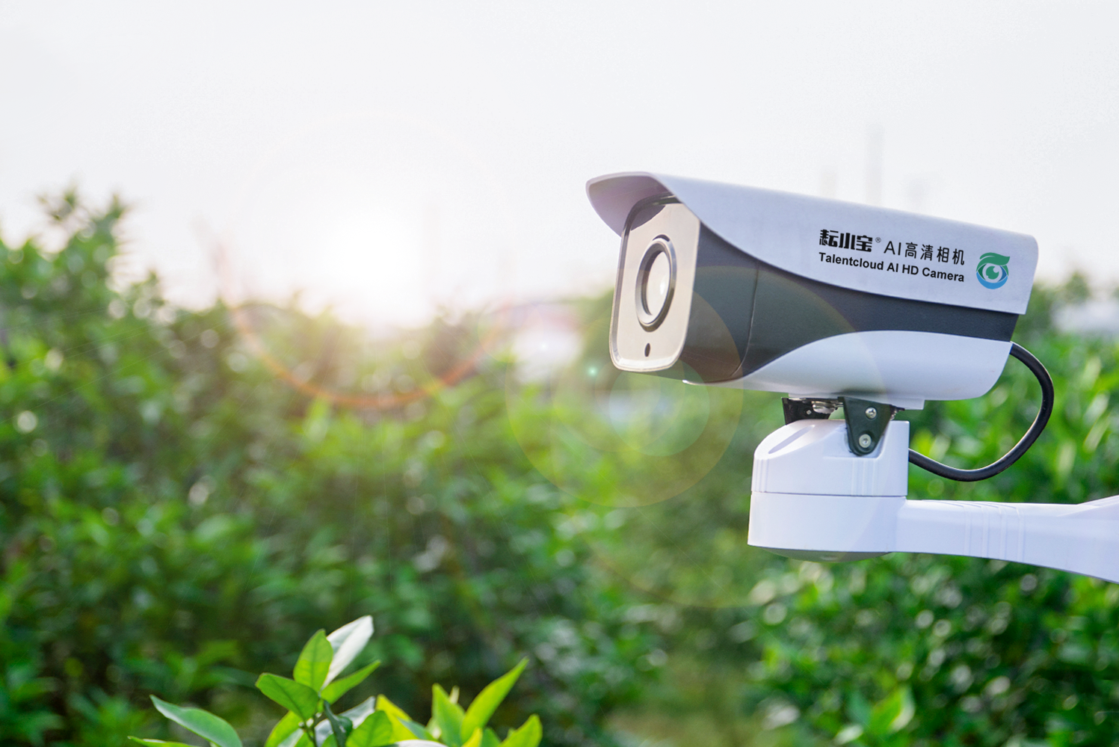
Why use Synthetic Imaging Data for Machine learning Tasks in Agriculture?
Inexpensive to create Images
Lower labour and machine costs
Allows to simulate different environments in order to test effectiveness of machine learning model
Scalability advantage

Slide 6
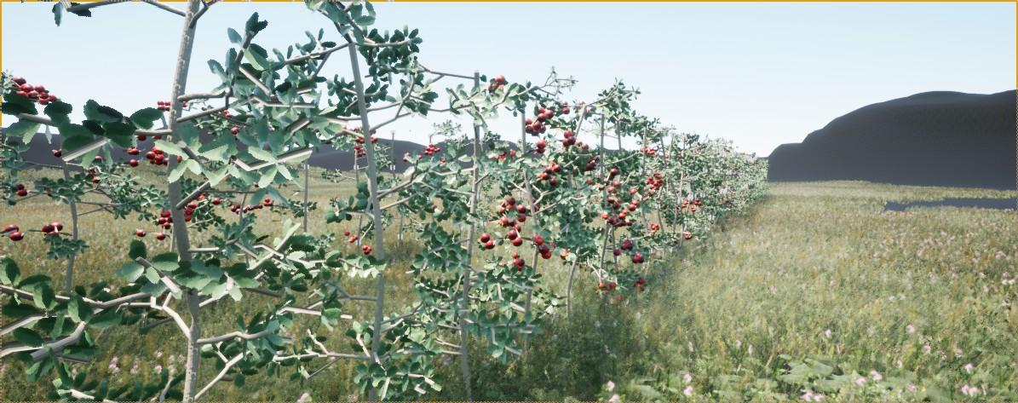
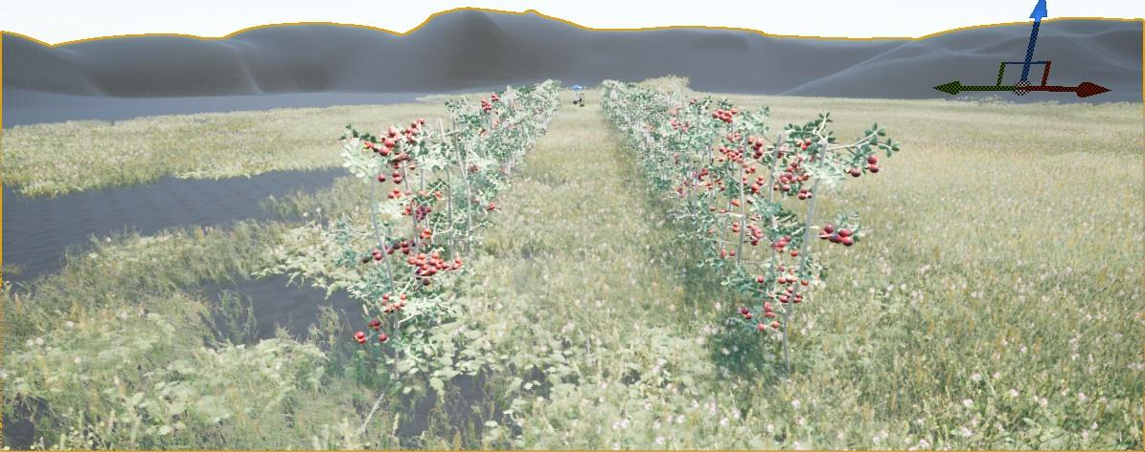
Unreal Engine for creation of 3D images of Apple Orchard Field
Gives control over simulated environment
Variable direct lighting
Drawbacks of Unreal Engine
Expensive to create realistic apple orchard environment.
Solution:
Deep Generative Adversarial Networks(GANs)

Slide 7
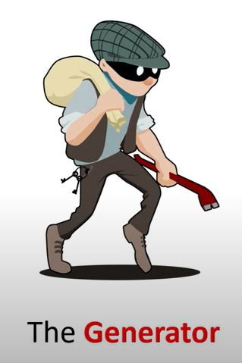

Generative Adversarial Networks (GANs)
This is the class of machine learning techniques in which two networks (generator,discriminator) playing adversarial roles against each other.
Generator:
This is neural network system which aims to
deceive the other network. It captures joint probability P(X,Y)
Discriminator:
This is neural network which works as detective to classify between real and fake data. It captures conditional probability P(Y|X)

Slide 8
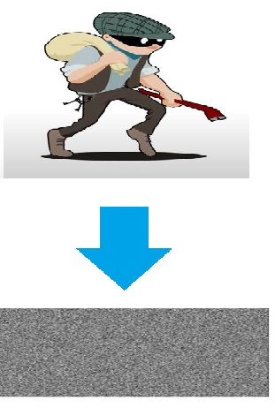
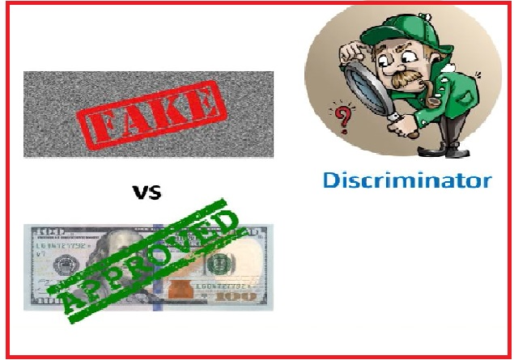
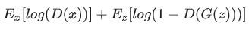
GANs in Training
GANs must juggle between
two different trainable networks
Convergence is challenging to
identify as it is fleeting rather stable
Minmax Loss Function:
Wasserstein Loss:
Critic Loss: D(x) - D(G(z)) , Generator Loss: D(G(z))

Slide 9
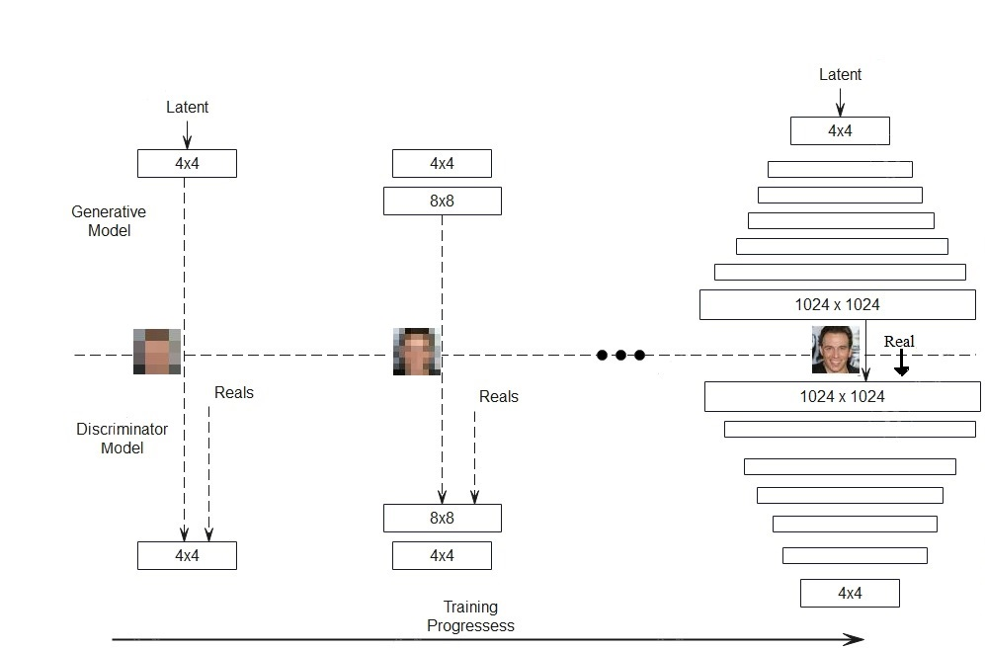
First Approach
Progressive GANs:
This is the extension of GANs which produce higher resolution images by iteratively adding layers to the network, during the training.
Progressive Addition of layers
Mini Batch Std
Pixel Normalization
Equalized Learning Rate
This allows to discover larger scale of the image and then add finer details

Slide 10
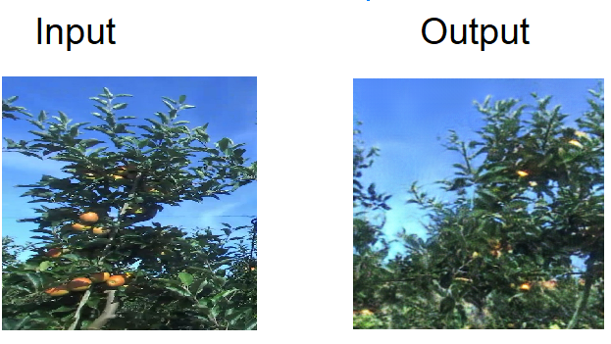
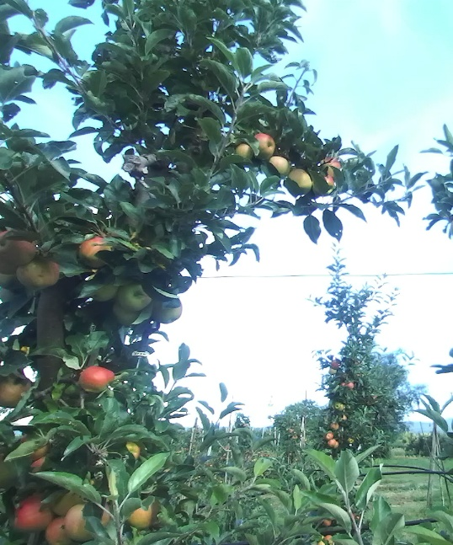
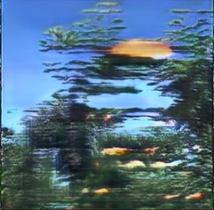
Training of ProGANs
Training of the ProGANs is very challenging because it requires significant amount of imaging data and training time
Adding layers iteratively complicate the stability of the training of ProGANs
For training data, 11000 images of real apple orchard field was selected as compared to 800 K images in research paper

Slide 11
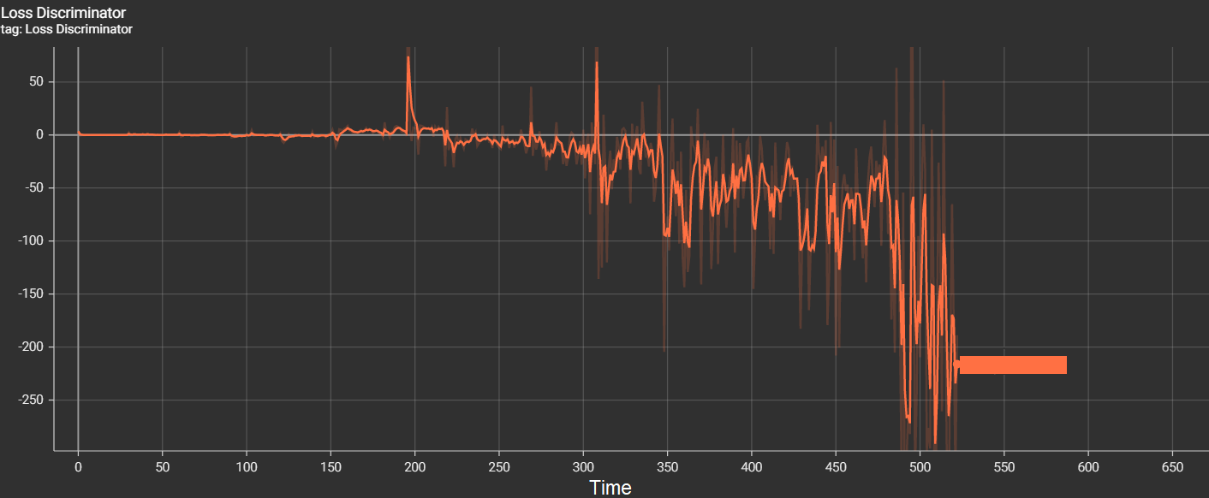
Wasserstein GANs(WGAN_GP) loss is used which during the training which suggests that model is not converging well. The reasons are:
Imaging Data Volume Constraint
Hardware Memory Constraint
complex network architecture

Slide 12
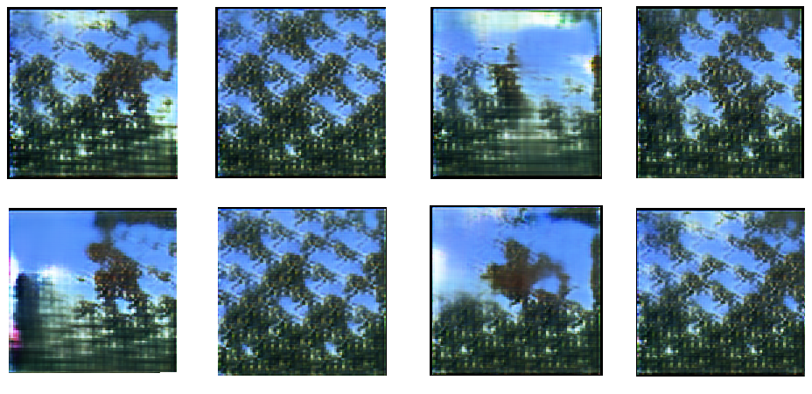
Training Data:

Slide 13
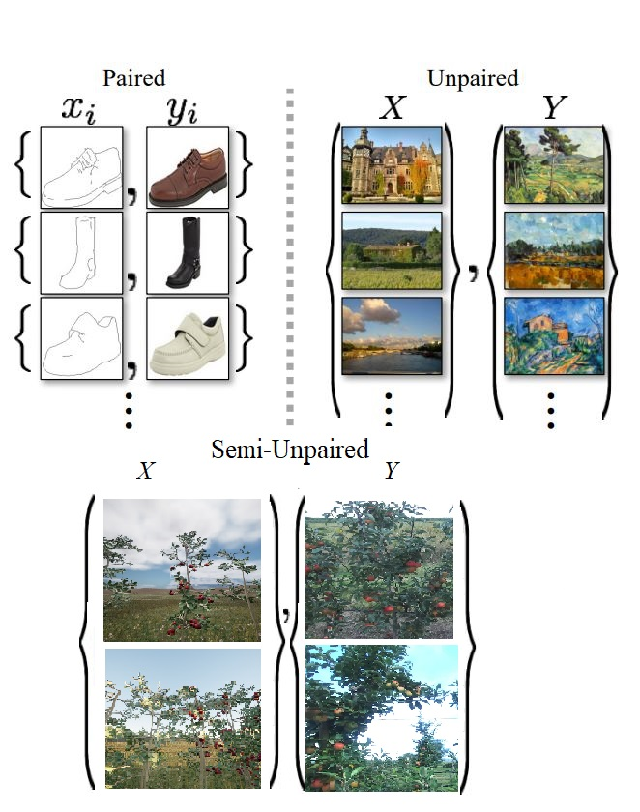
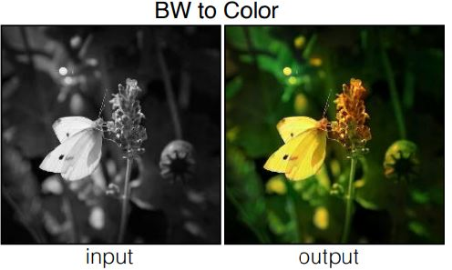
Second Approach
Cyclic GANs:
Cyclic GANs belongs to the class of image-to-image translation in which model learns the mapping between two imaging dataset.
Cyclic GANs is extension of pix2pix GANs. For training, it needs “Unpaired” training data
pix2pix is designed to learn the mapping between semantically similar domains.For training, it needs “paired” training data

Slide 14
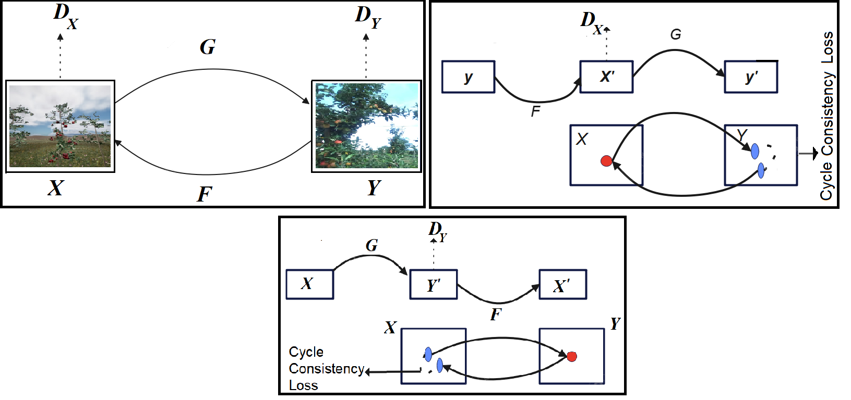
Cyclic GANs purposed functioning

Slide 15
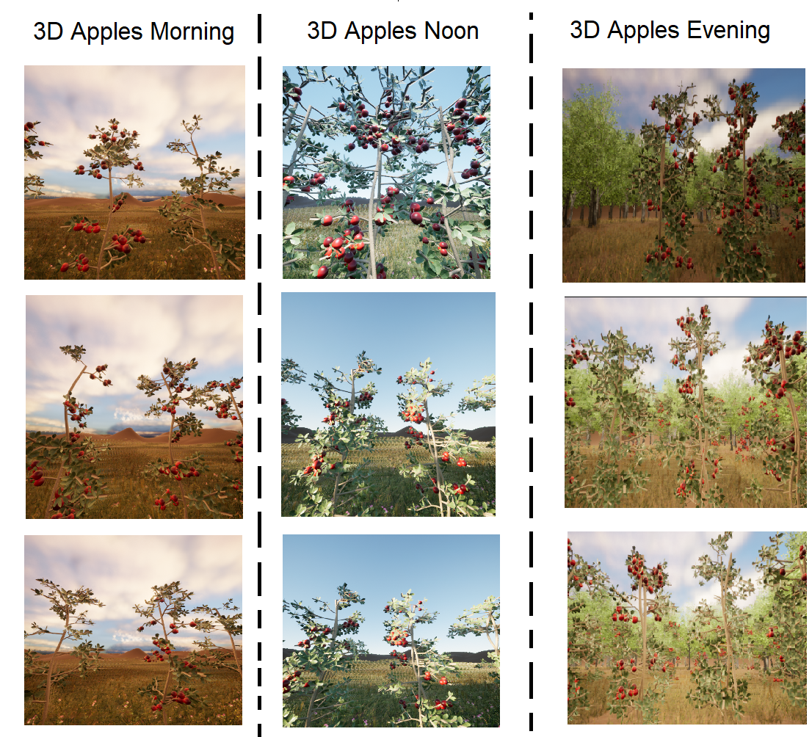
Training data distribution in daytime
Semi-paired 3D dataset is created in 3 stages of day time
Morning
Noon
Evening

Slide 16
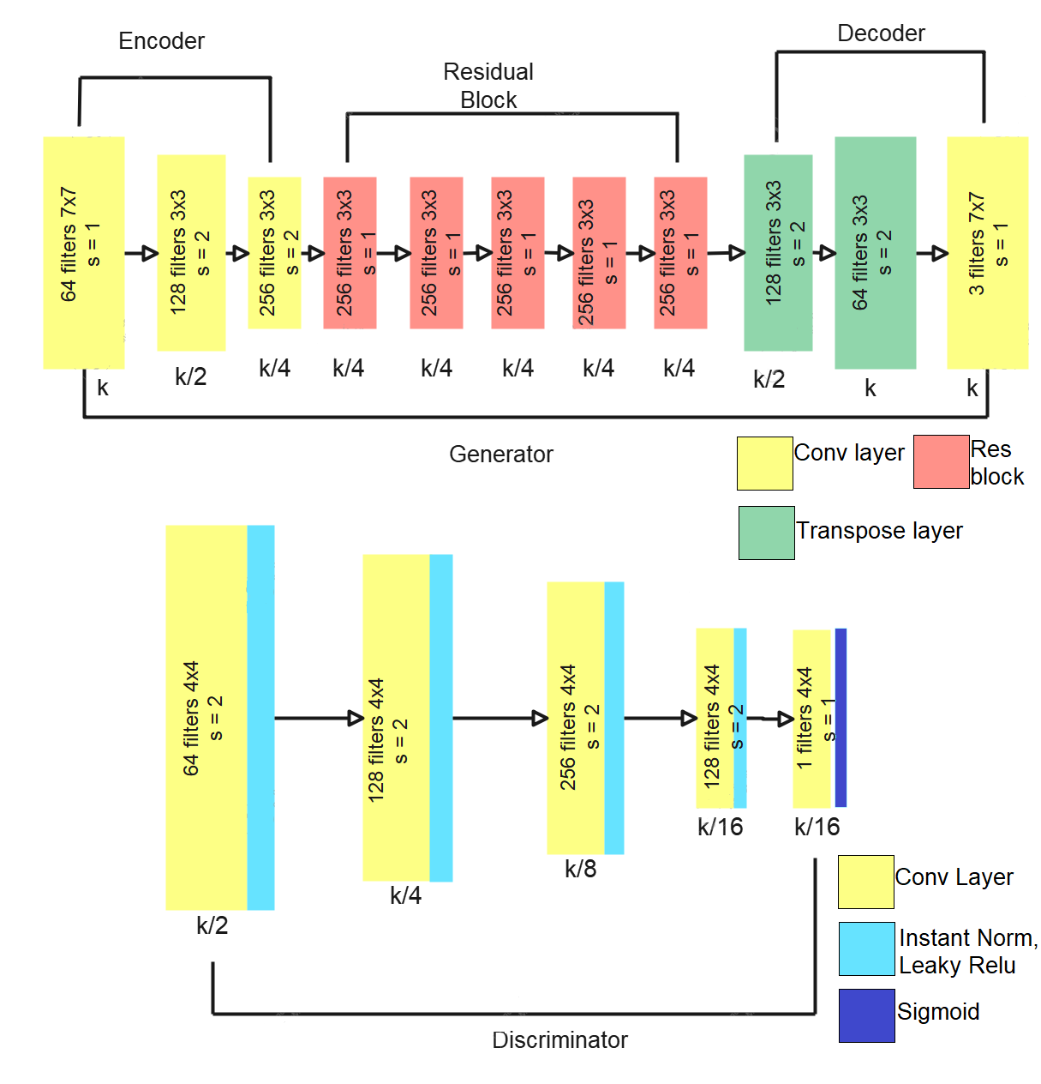
Architecture of deployed cyclic GANs

Slide 17
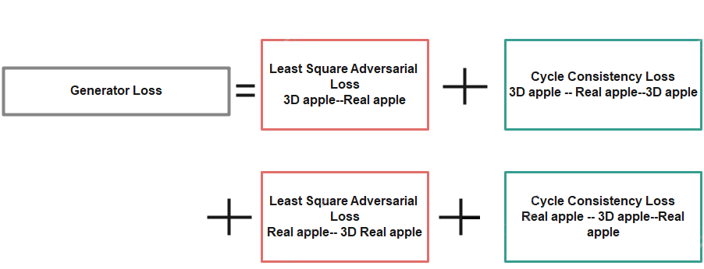

Slide 18
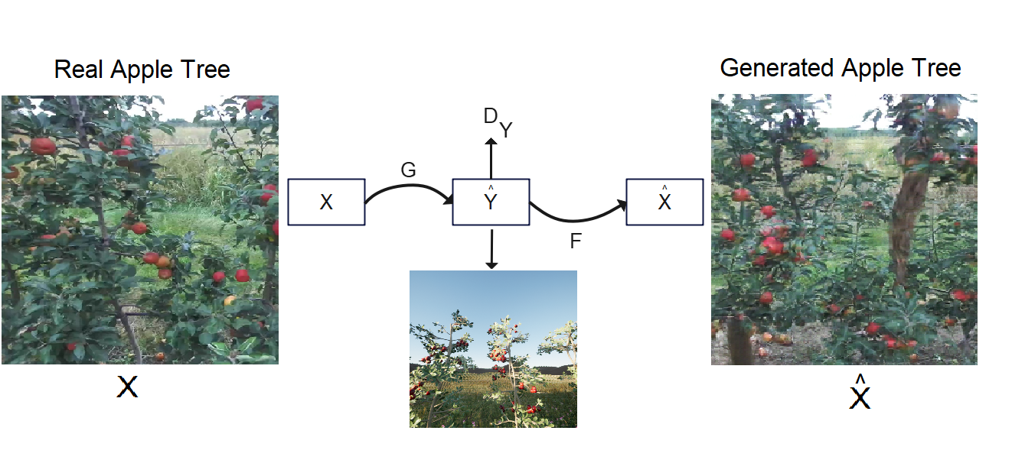
Training of Cyclic GANs

Slide 19
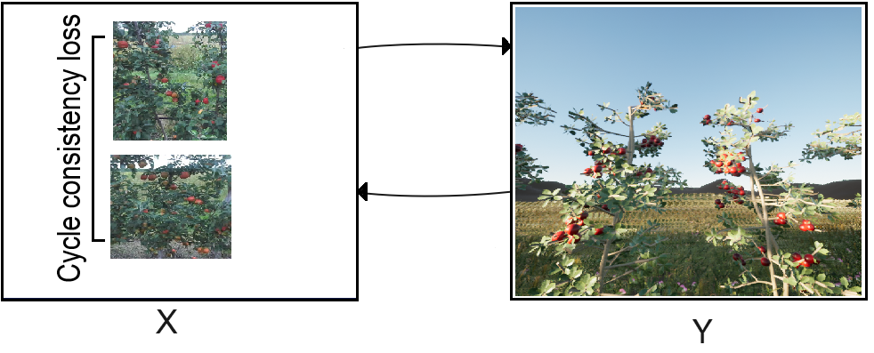

Slide 20
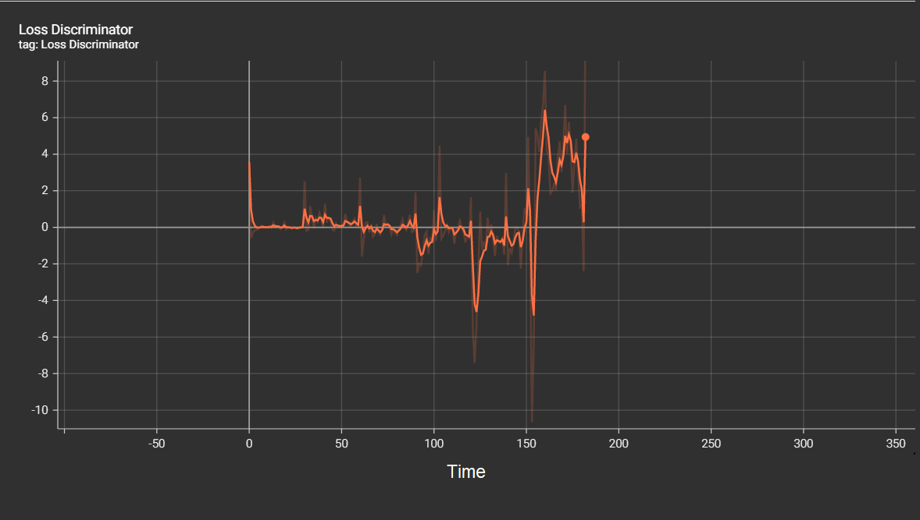
Critic Loss during Training

Slide 21
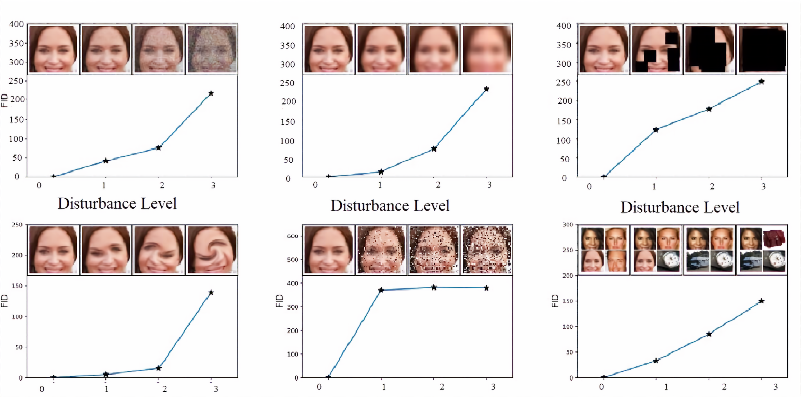
Fréchet Inception Distance (FID)
is a metric for evaluating the quality of generated images and specifically developed to evaluate the performance of generative adversarial networks.
FID is extension of IS in which estimation of quality of synthetic images is computed through classification of V3 Model.
Lower the score, better the results

Slide 22
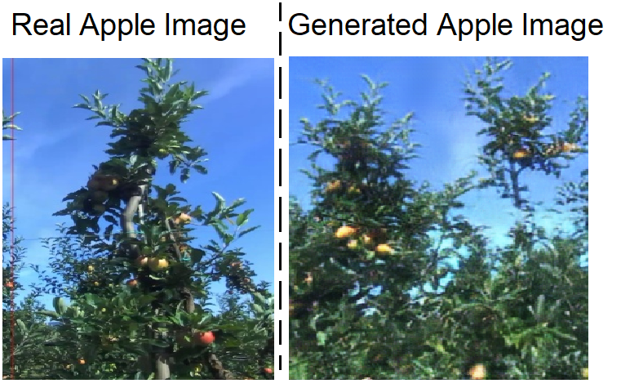
Experiments and Results
Progressive GANs:

Slide 23
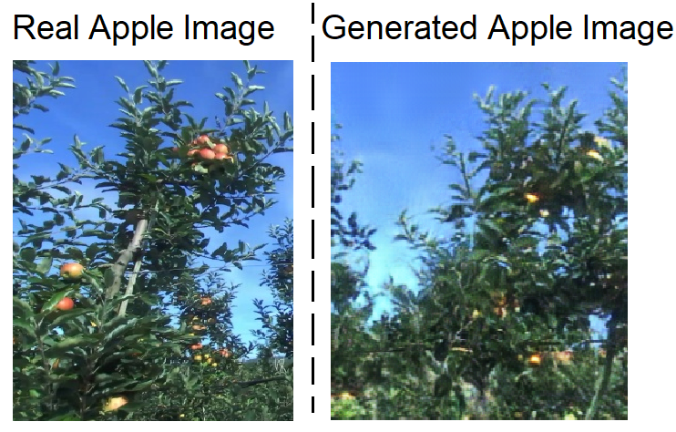
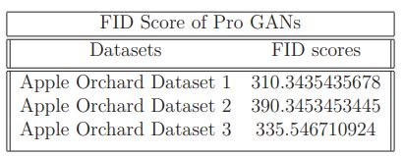

Slide 24
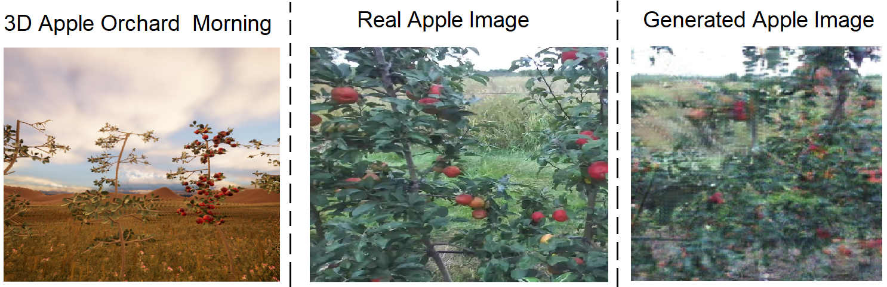
Cyclic GANs
Experiment 1:

Slide 25
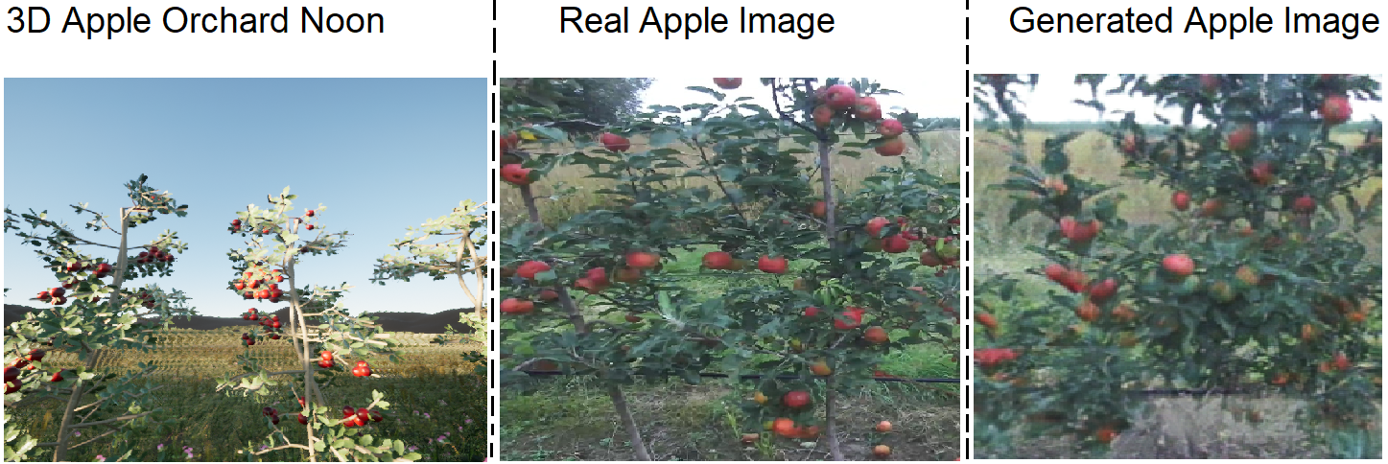
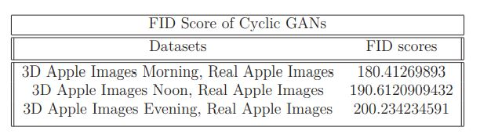

Slide 26
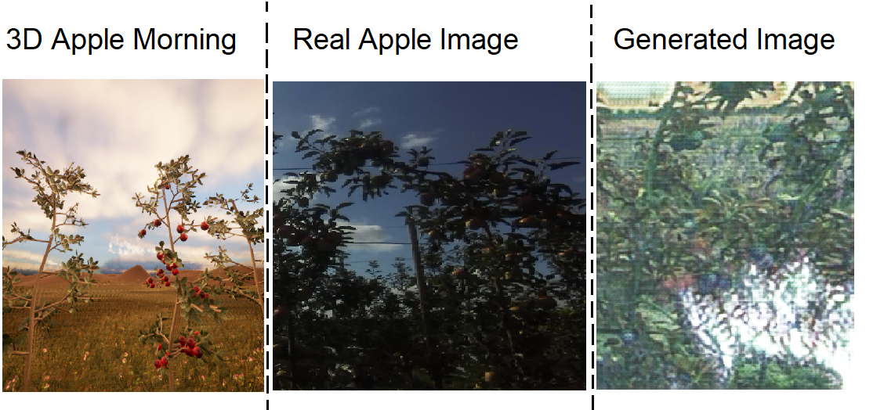
Experiment 2:

Slide 27
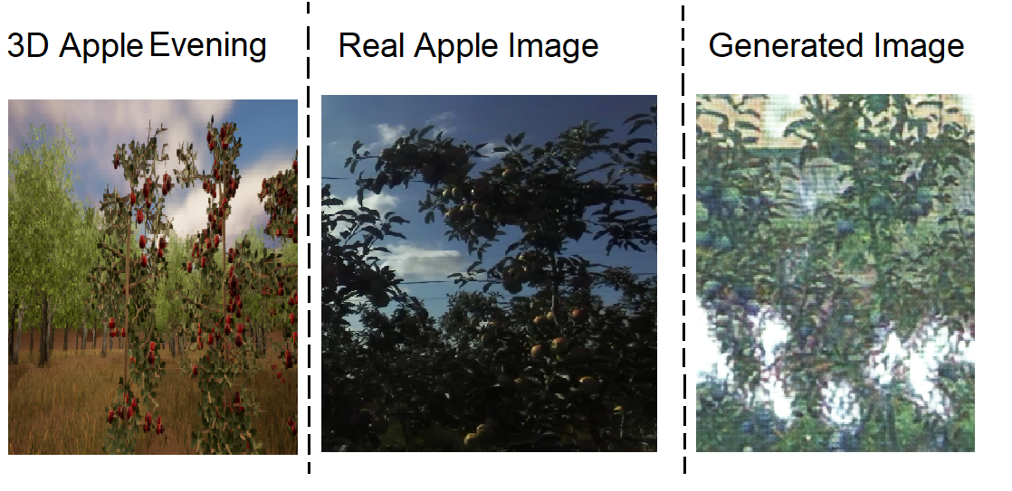
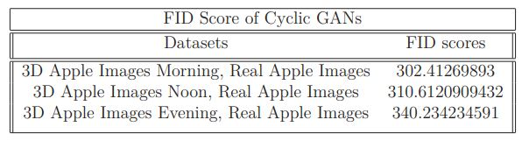

Slide 28
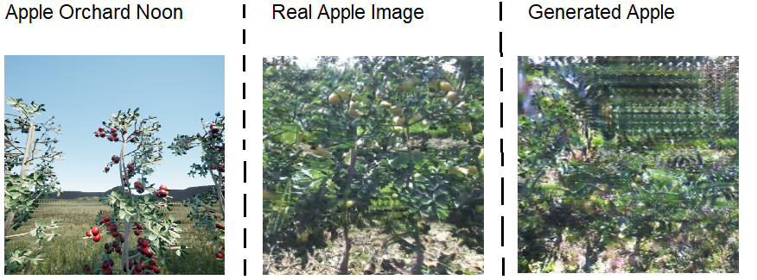
Experiment 3:

Slide 29
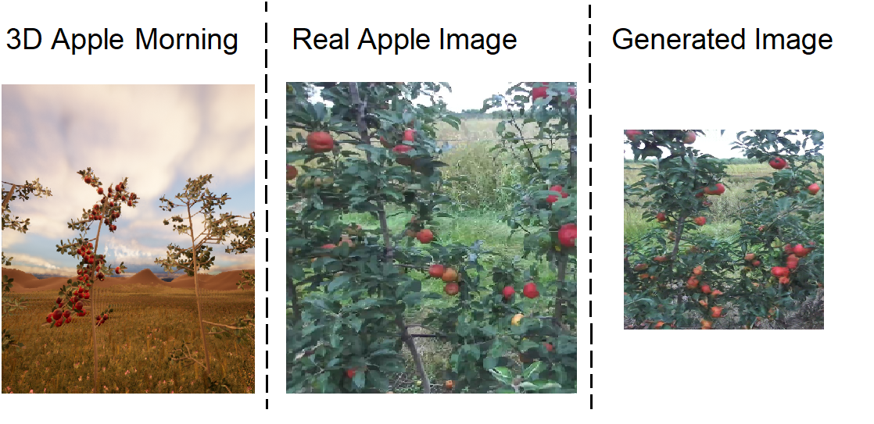
Experiment 4:

Slide 30
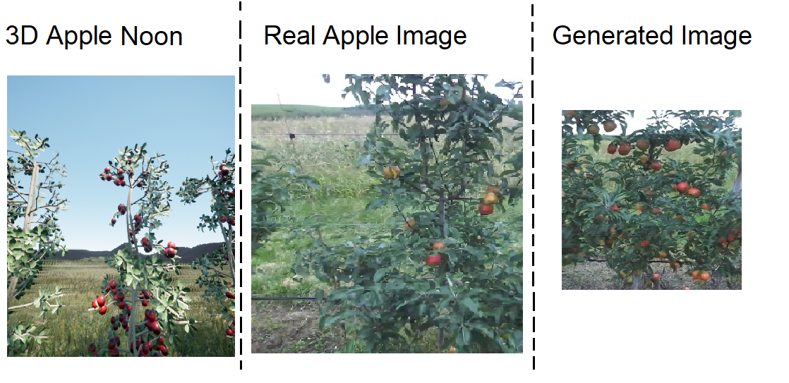

Slide 31
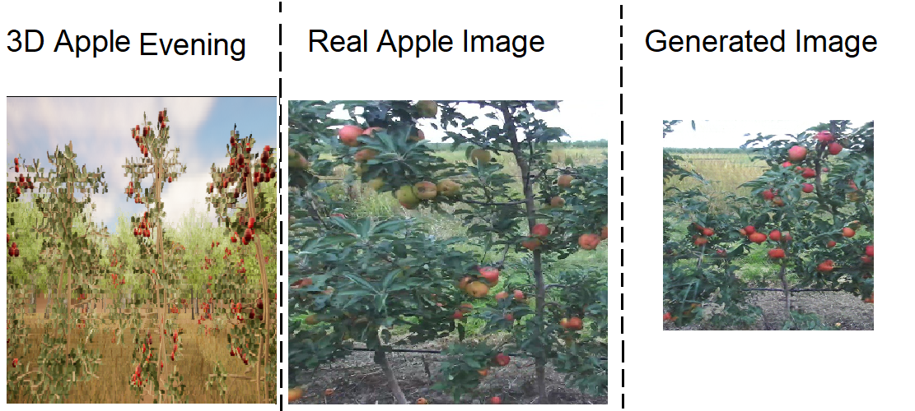
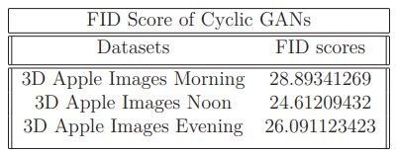

Slide 32
Problems and Future Work
Segmentation between background and foreground
Both domains must be semantically similar
The volume of training data
Change in architectural design
Better training hardware
More detailed 3D images of apple orchard in Unreal Engine
high end DSLR cameras for real apple images.

Slide 33


Slide 34
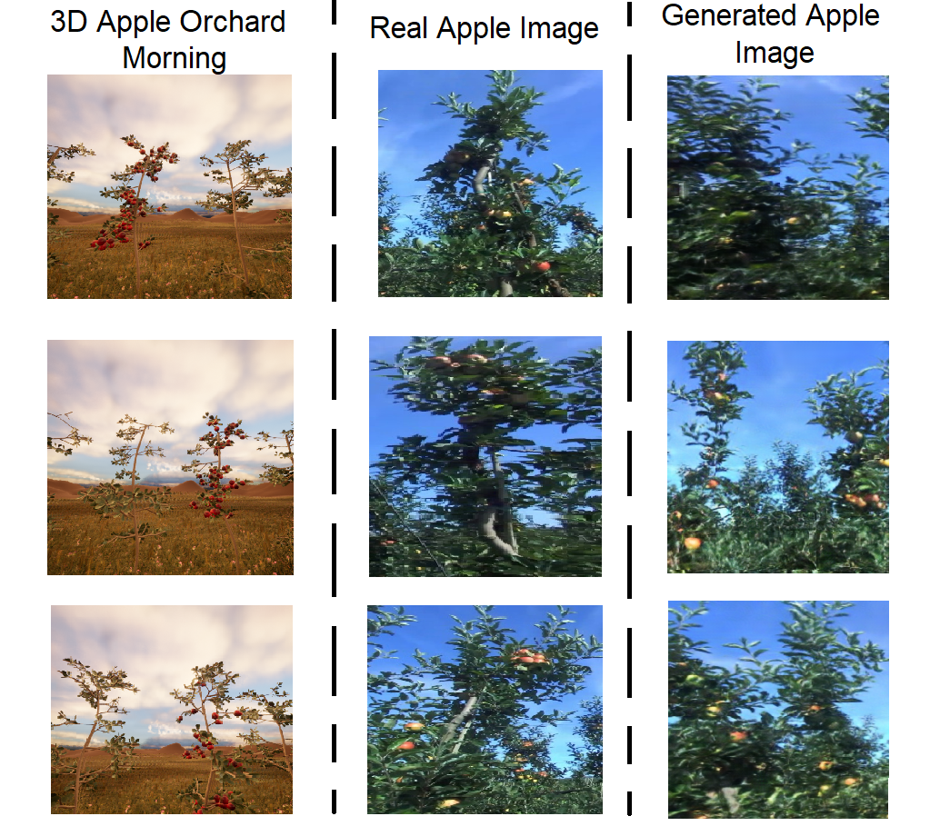
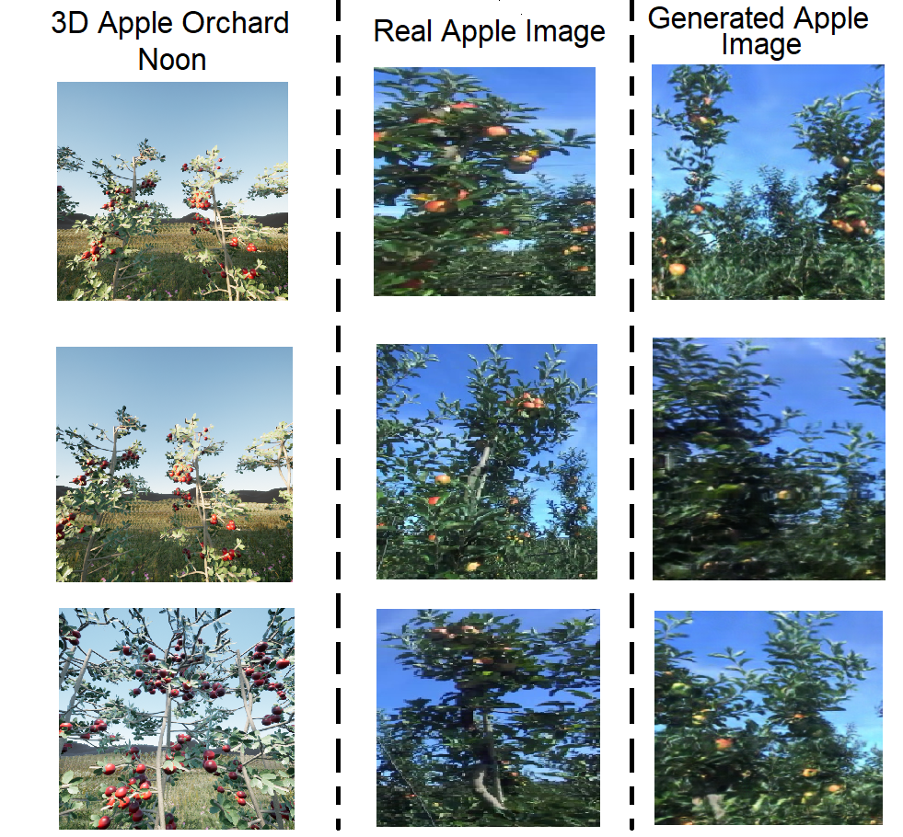
Backup Images

Slide 35
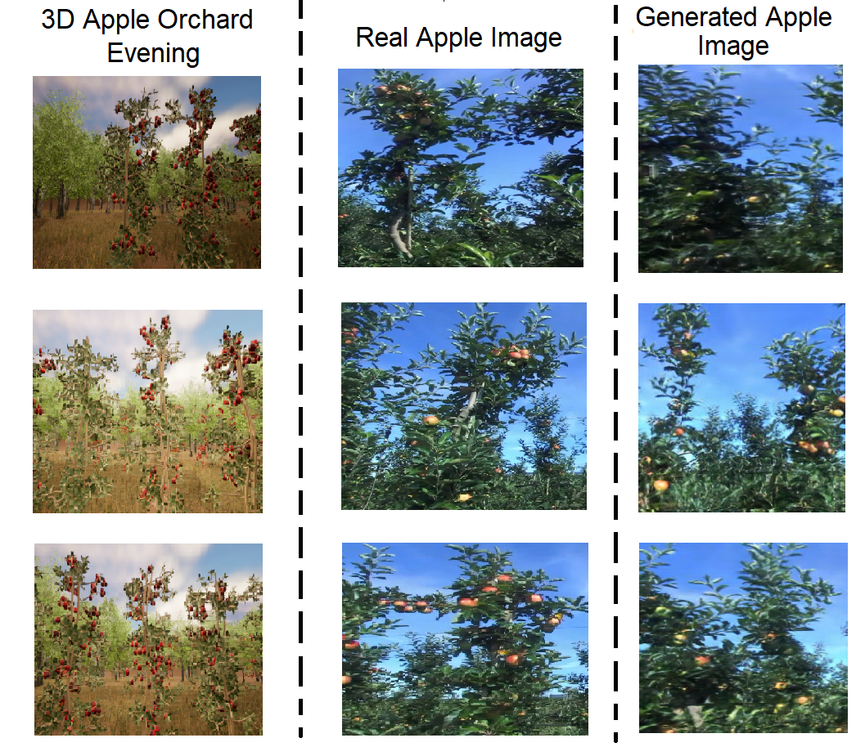

Slide 36
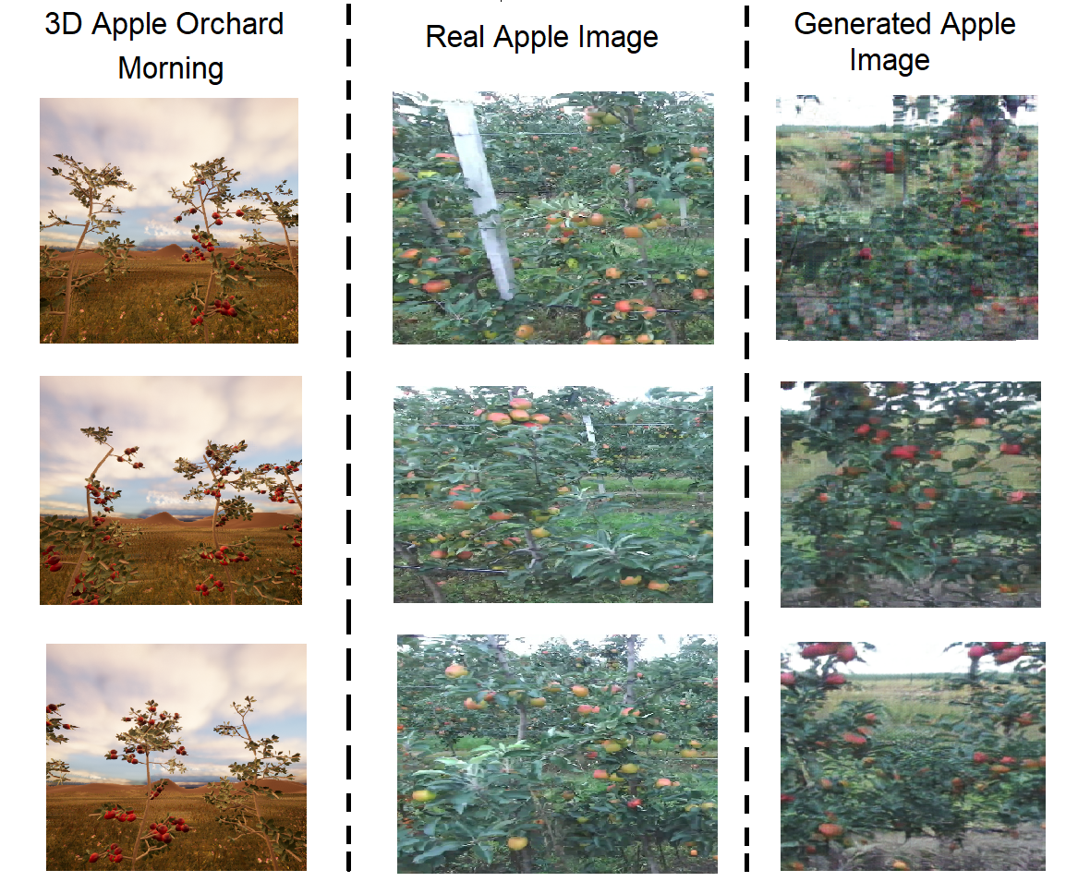

Slide 37
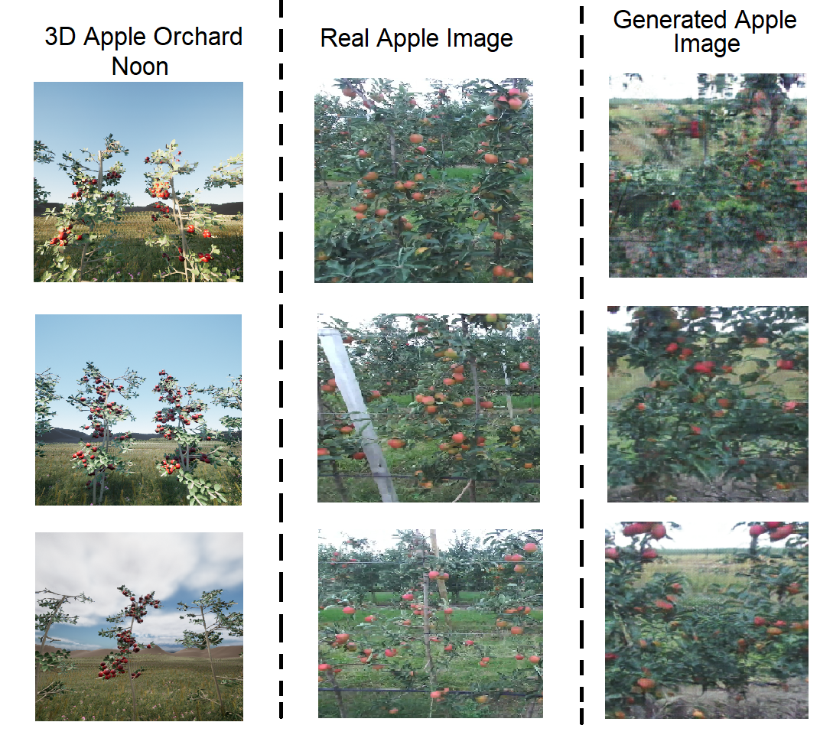

Slide 38
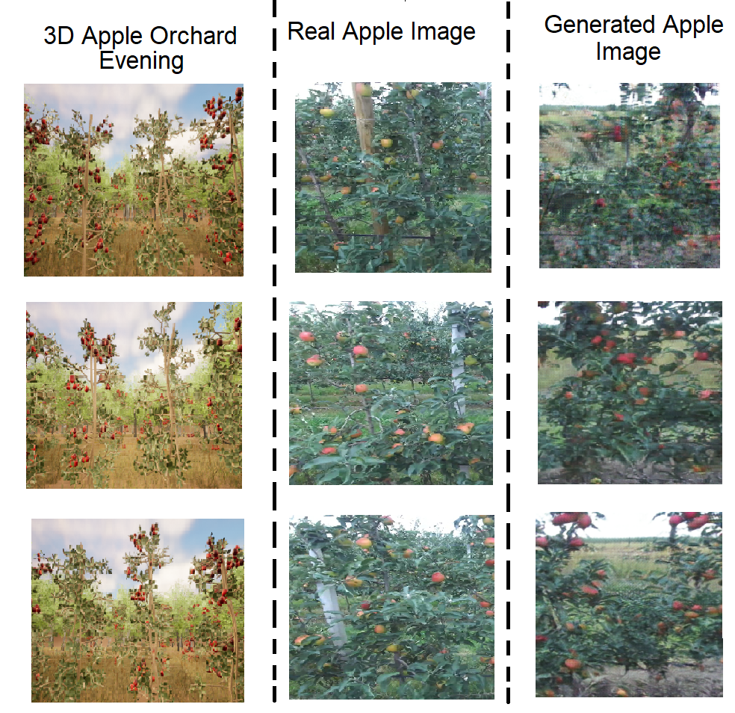

Slide 39



Slide 40


Slide 41



